Slide 1
Four Intrusion Cases
4 May 2015: Daytime Intrusion
6 May 2015: Early Morning Inversion
6 – 7 June 2015: Two burns, Nighttime Intrusions
6 Oct 2014: Morning Inversion

Slide 2
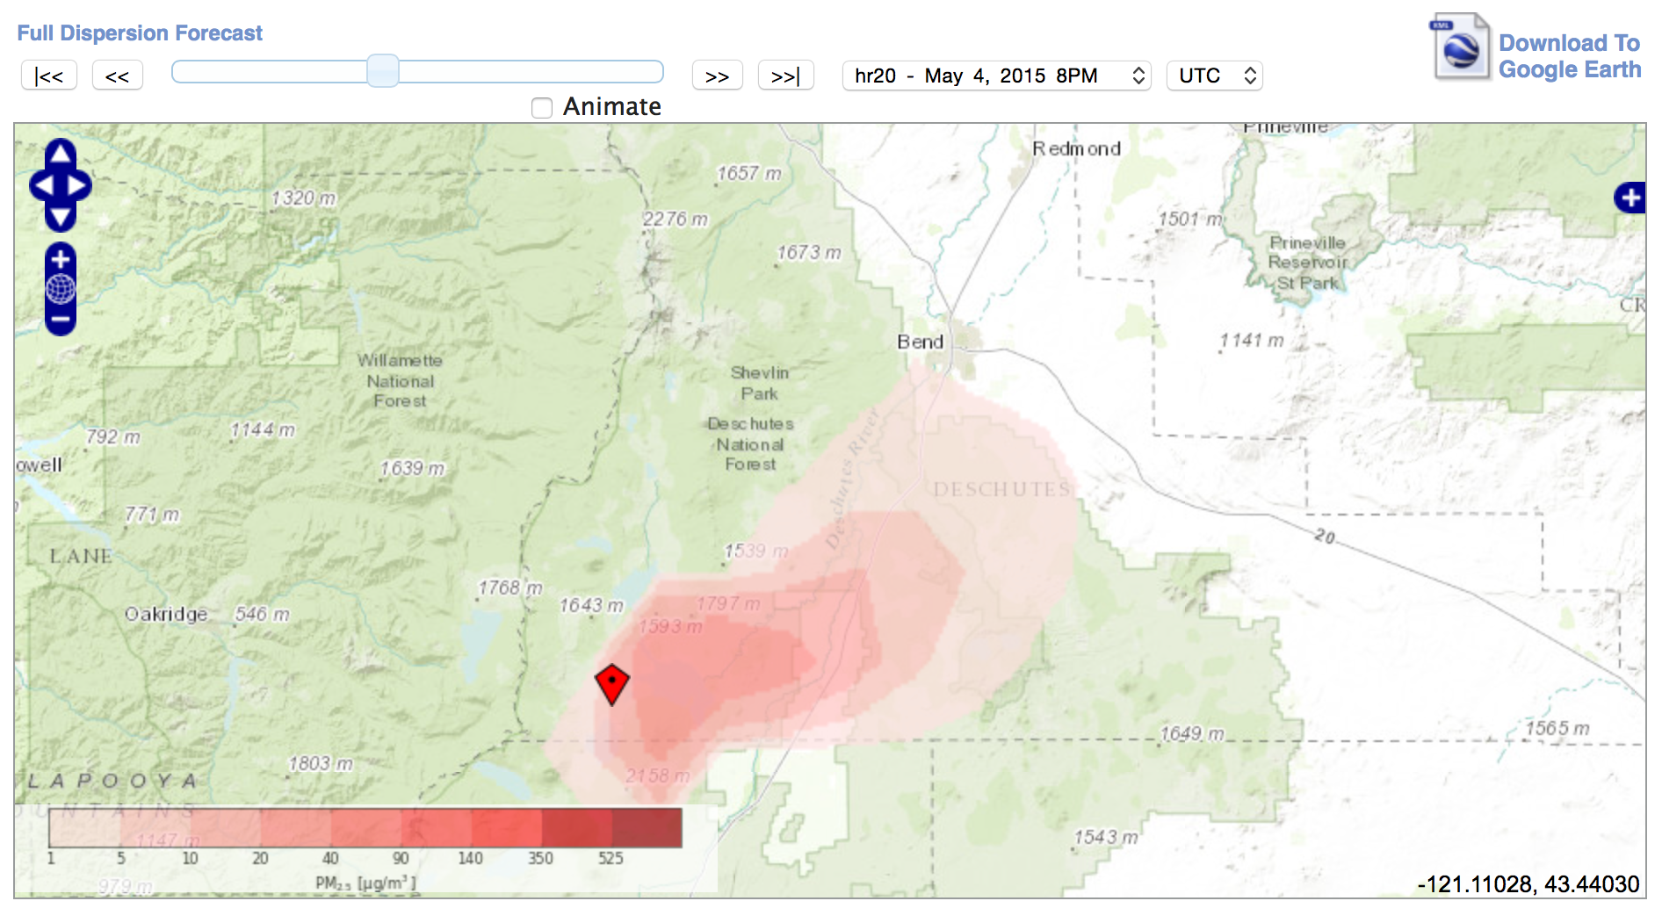
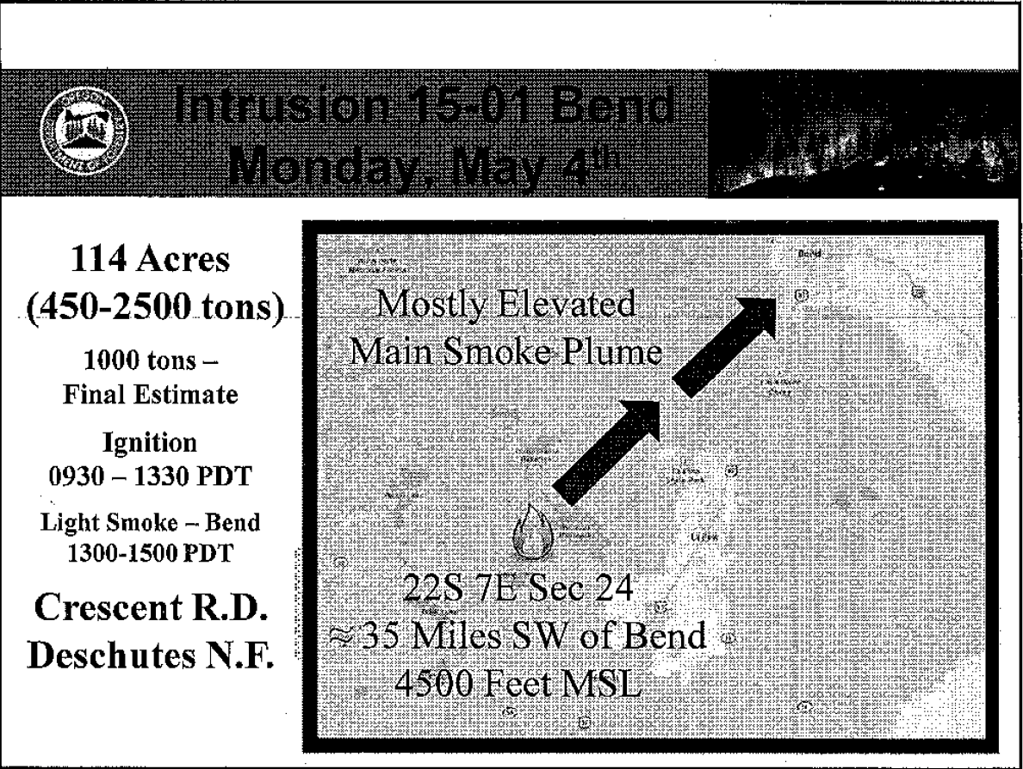
4 May 2015 13:00 PDT
4 May 2015 – Afternoon smoke intrusion into Bend from same-day prescribed burn. Smoke in Bend from 1PM – 3PM PDT.

Slide 3
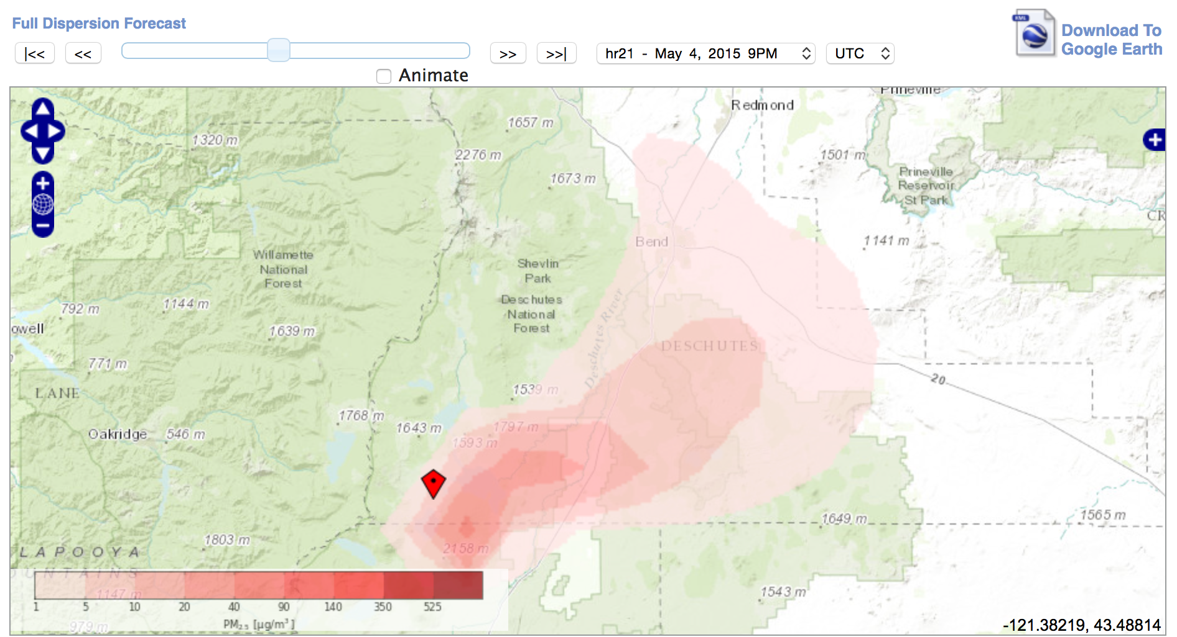
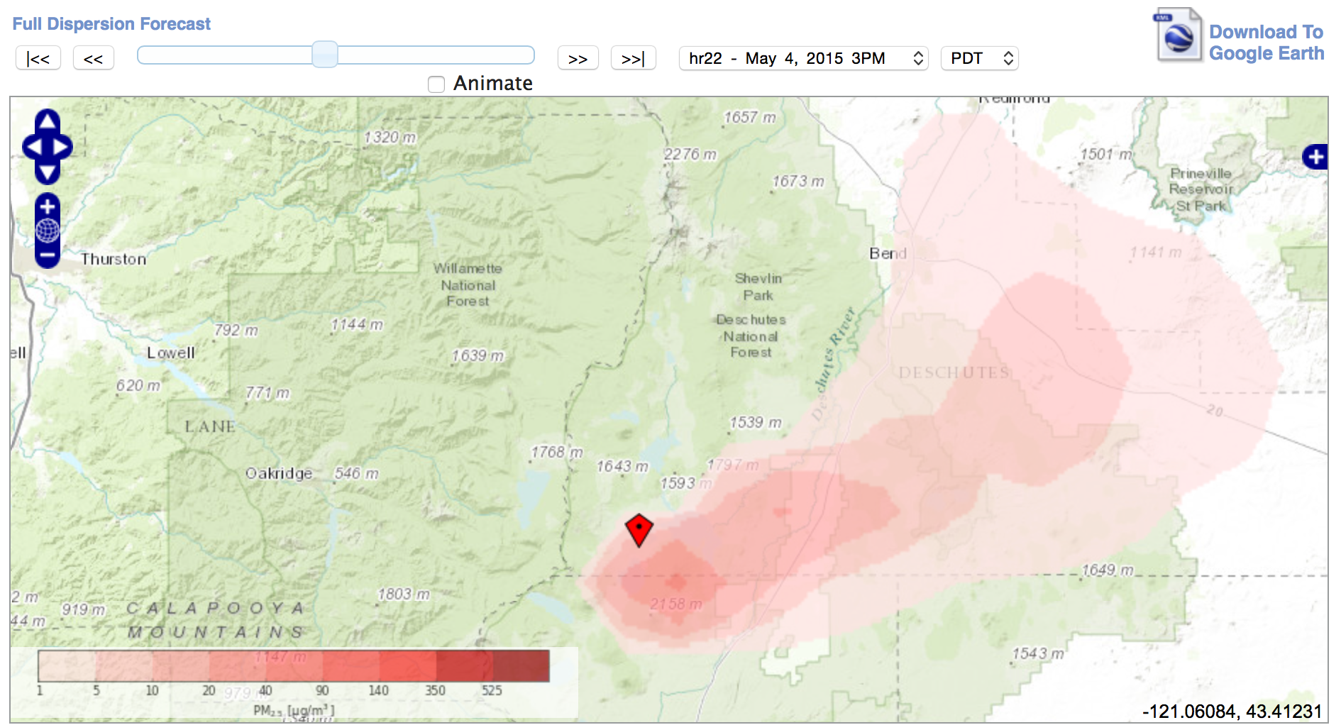
4 May 2015 14:00 PDT
4 May 2015 15:00 PDT

Slide 4
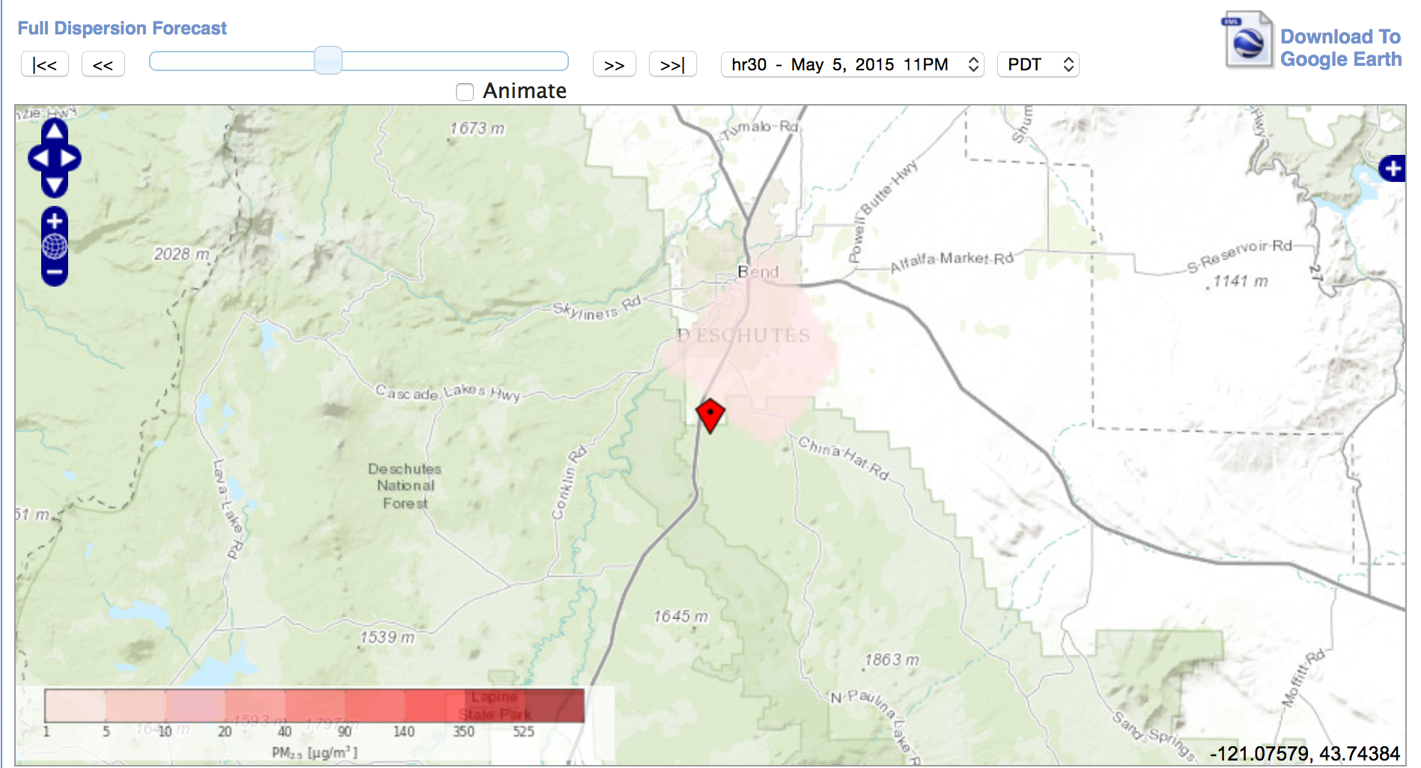
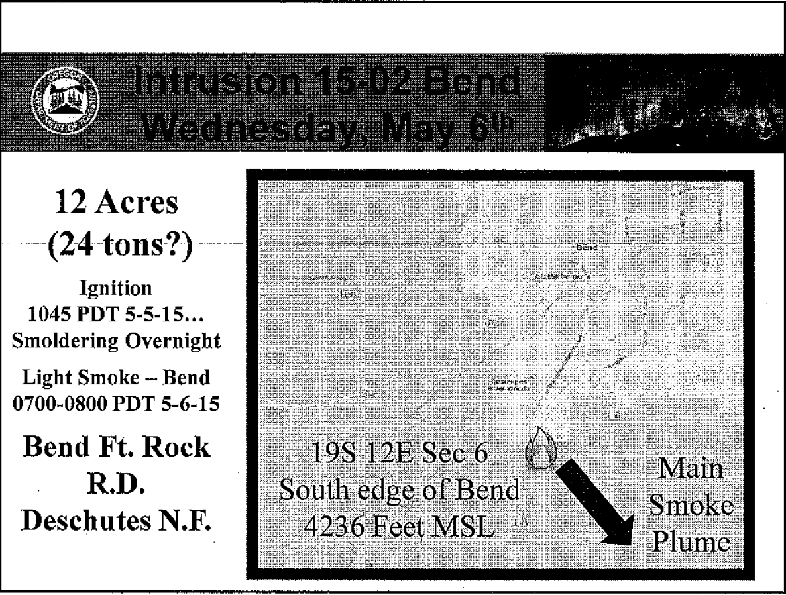
5 May 2015 23:00 PDT
6 May 2015 – Morning smoke intrusion into Bend from previous-day prescribed burn. Smoke in Bend from 7AM – 8AM PDT
BlueSky predicted smoke in Bend but missed the timing of the intrusion

Slide 5

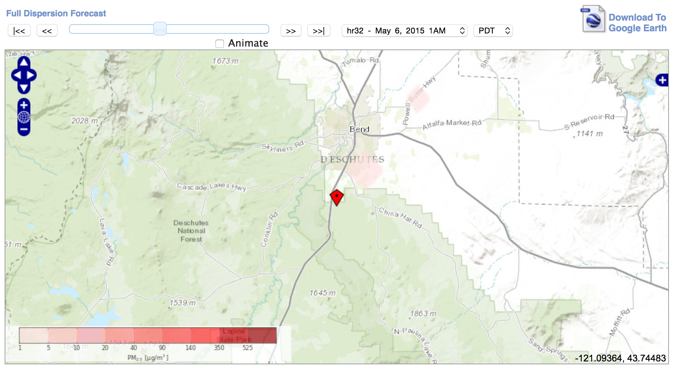
6 May 2015 00:00 PDT
6 May 2015 01:00 PDT

Slide 6
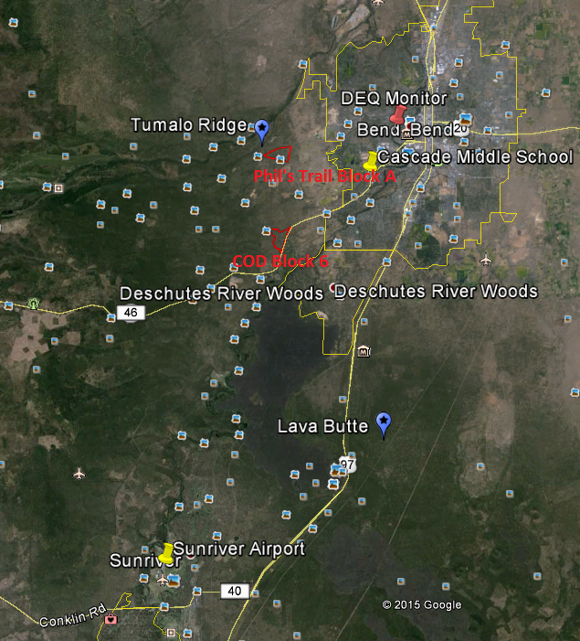
Locations of Fires and Monitors, 6/5/2015 (Phil’s Trail) and 6/6/2015 (COD)

Slide 7
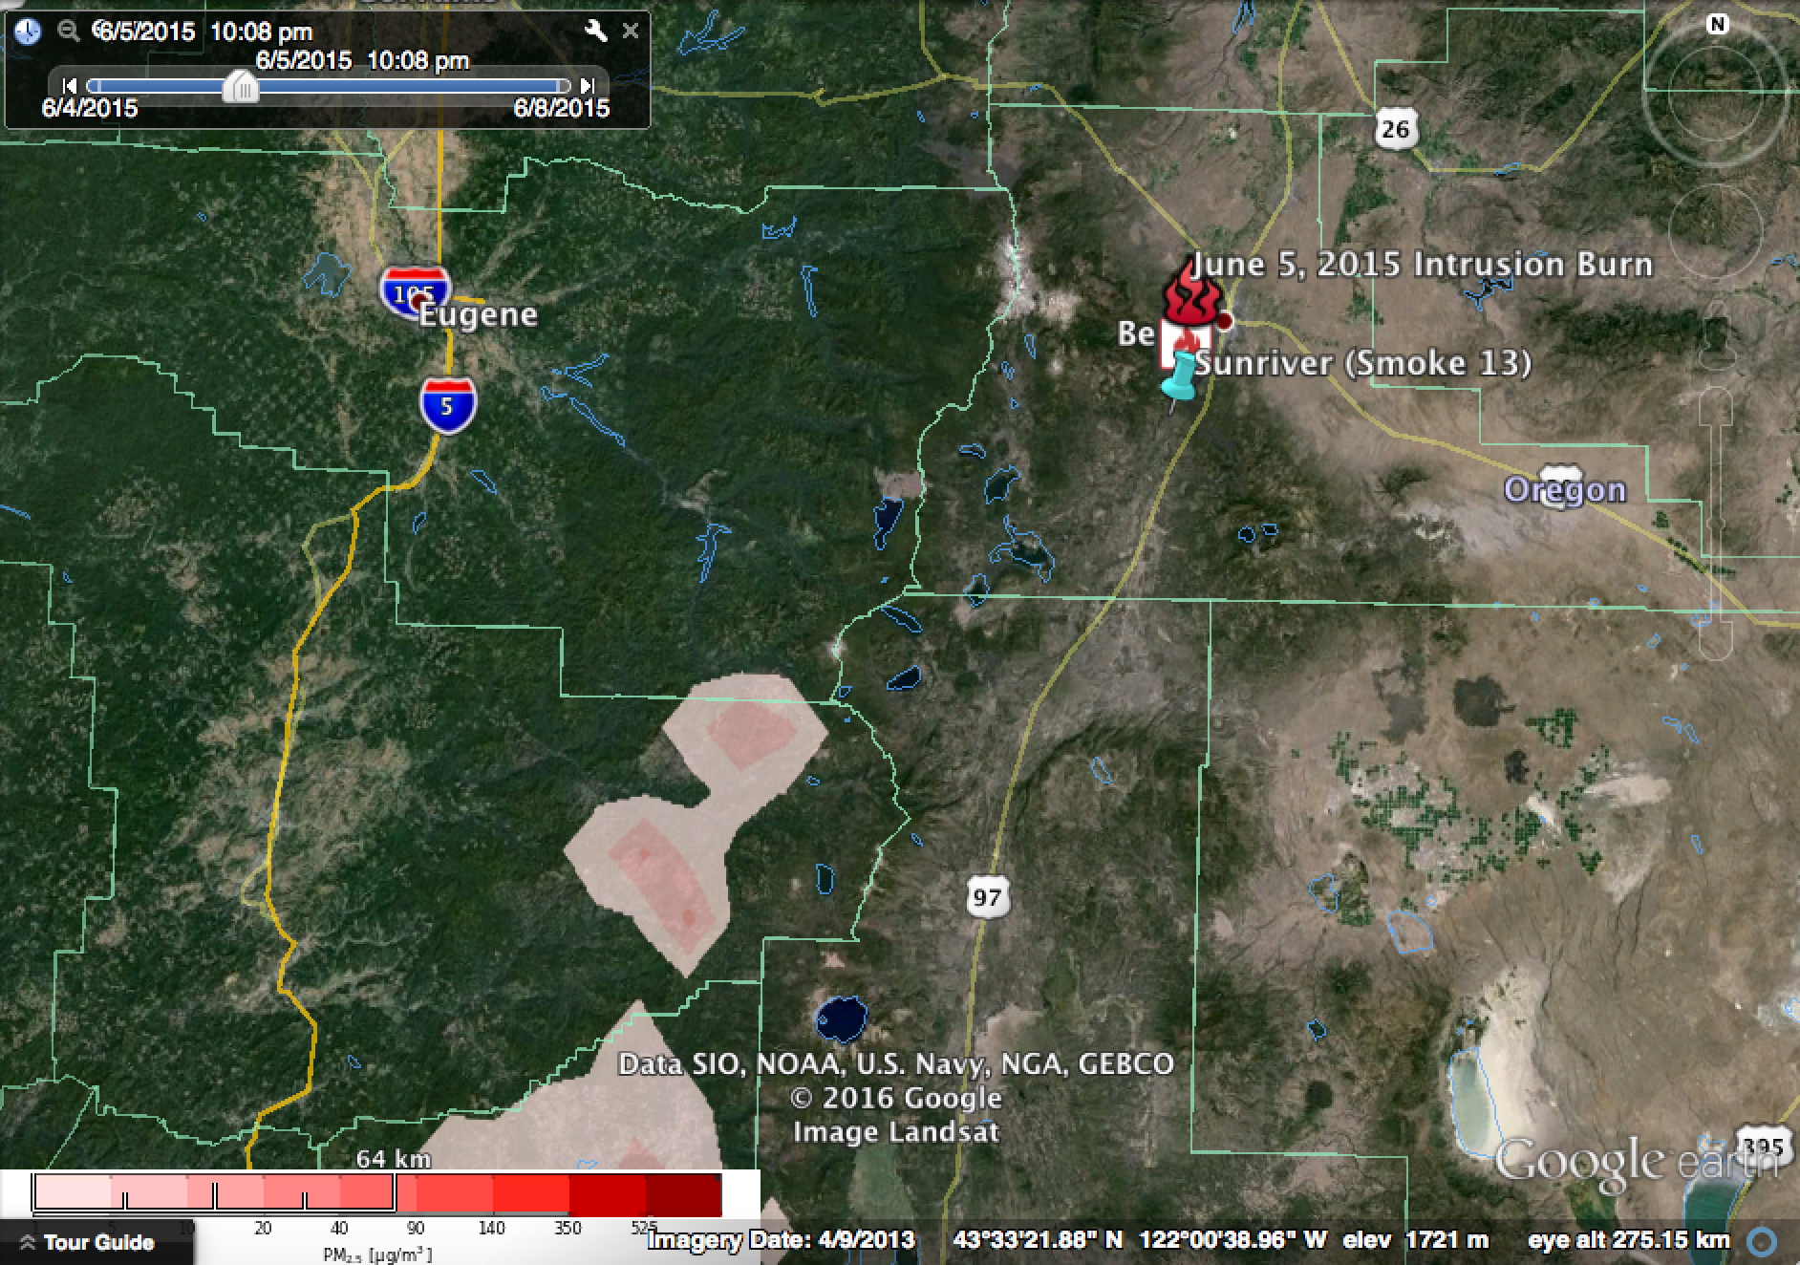
First smoke into Bend from Phil’s Trail, 6/5/2015 22:00 PDT. Missed by BlueSky.

Slide 8
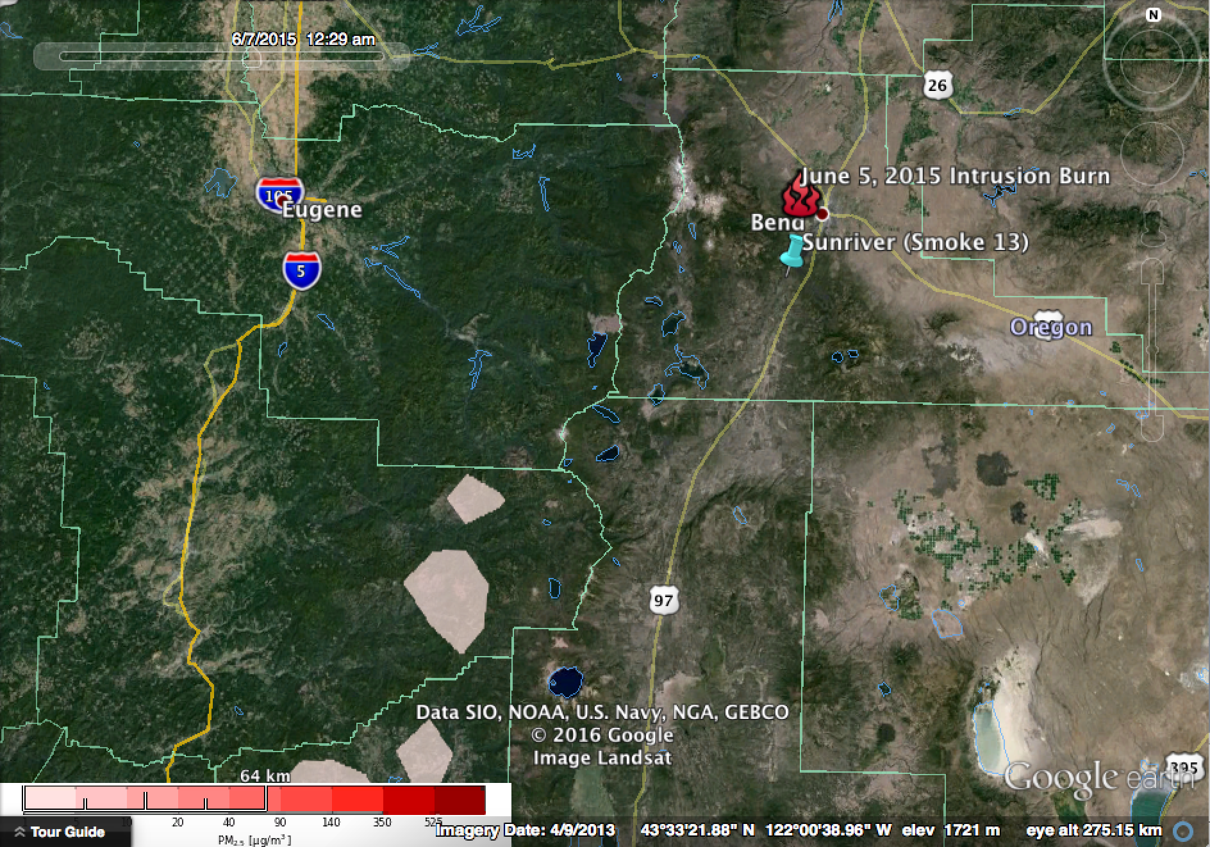
Second smoke into Bend from COD, 6/7/2015 00:00 PDT. Missed by BlueSky.

Slide 9
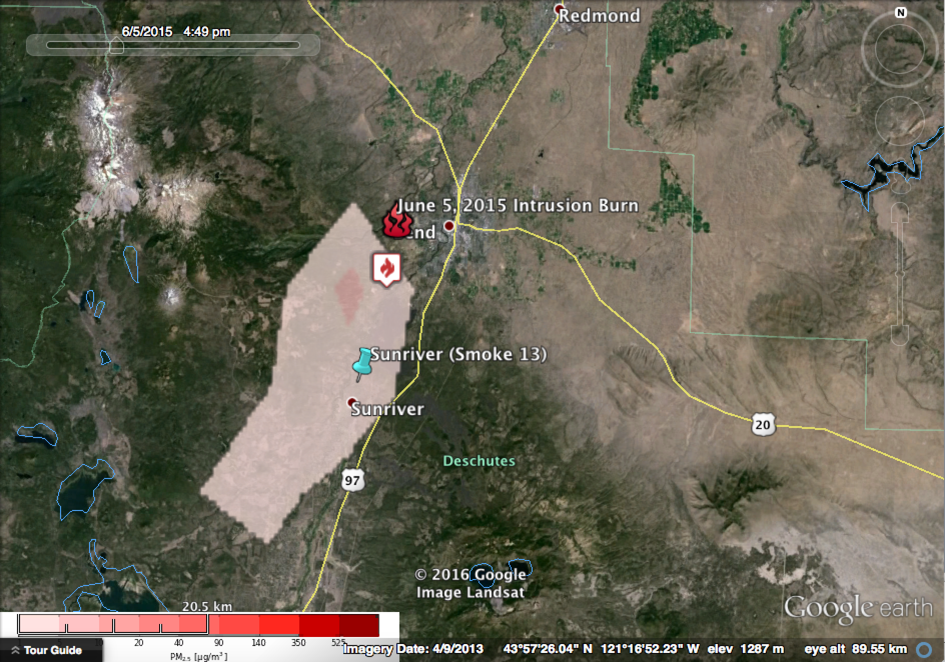
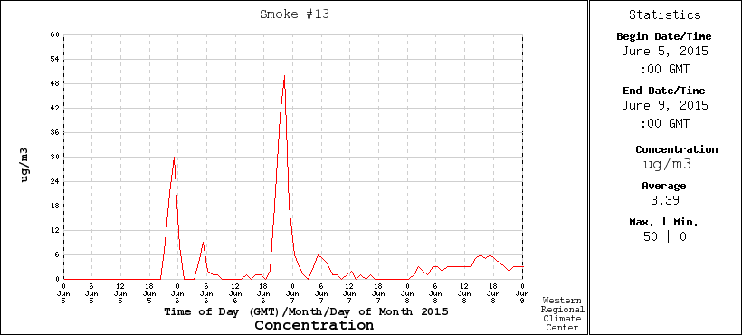
Smoke into Sunriver from Phil’s Trail, 6/5/2015 17:00 PDT. Confirmed by BlueSky.
(Note, times on graph are in GMT. Subtract 7 hours to convert to Local Time (PDT))

Slide 10
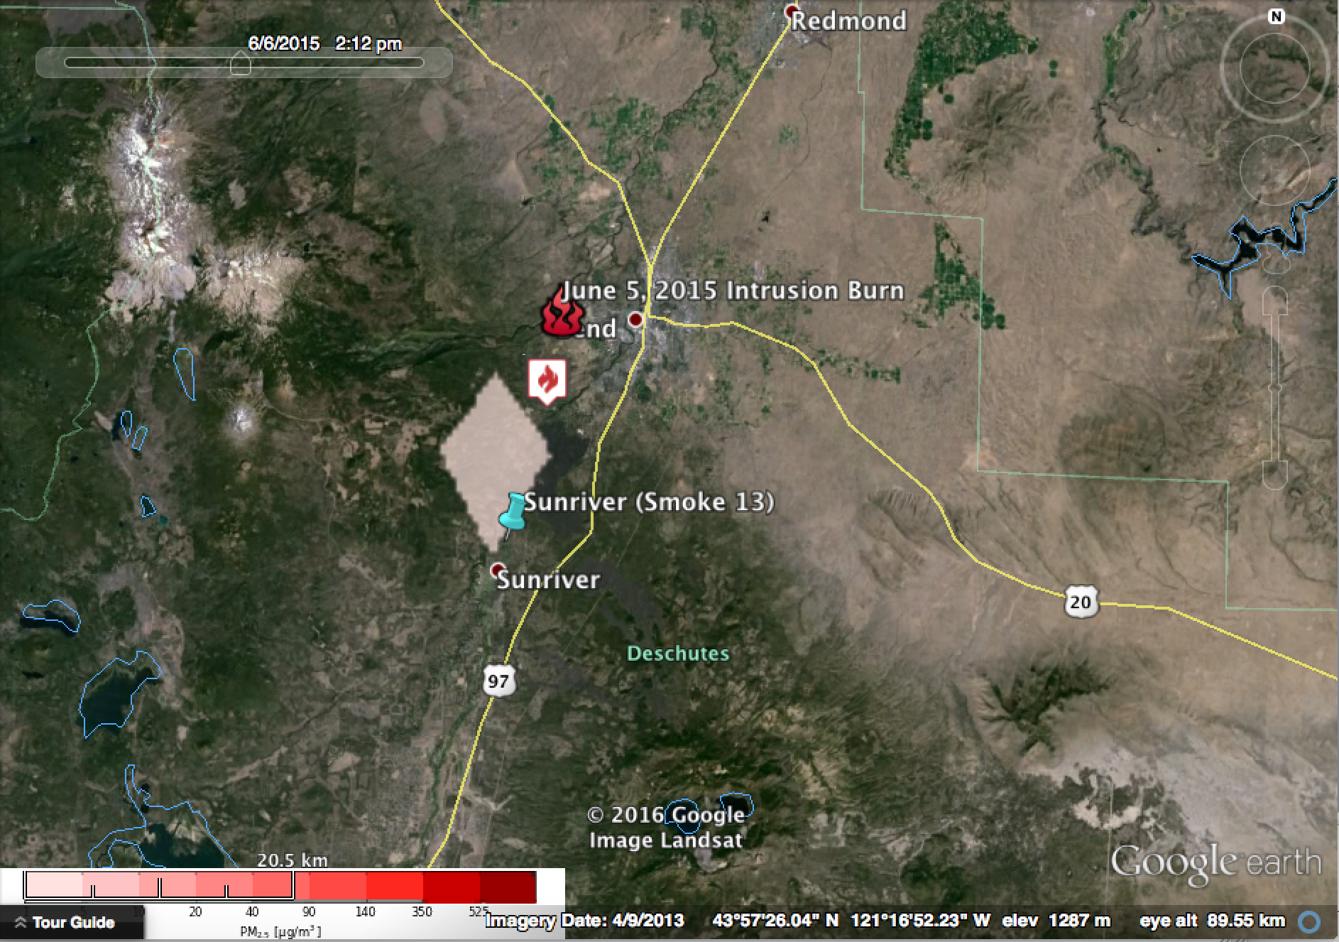
Smoke into Sunriver from COD, 6/6/2015 14:00 PDT. Confirmed by BlueSky.
(Note, times on graph are in GMT. Subtract 7 hours to convert to Local Time (PDT))

Slide 11
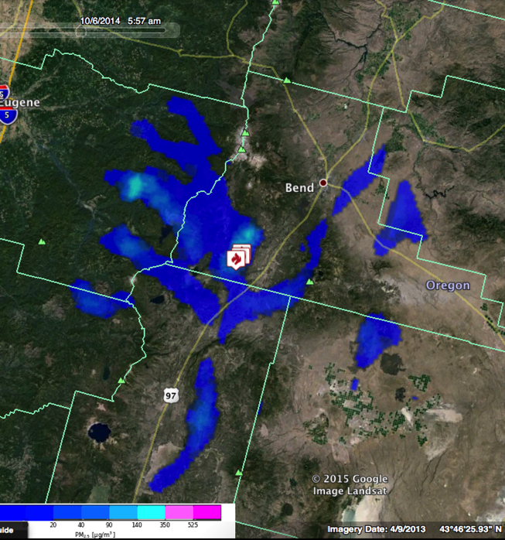
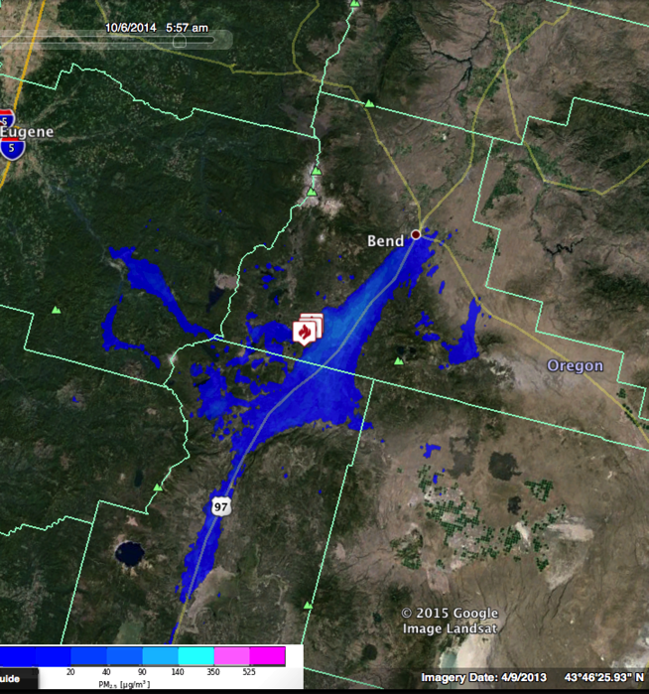
6 Oct 2014, 5AM PDT – Morning intrusion into Bend from previous-day prescribed burn using different spatial resolutions
Daily scheduled BlueSky run – PNW 4km met
Custom hi-res BlueSky run –NWS FW 1km met

