Slide 1
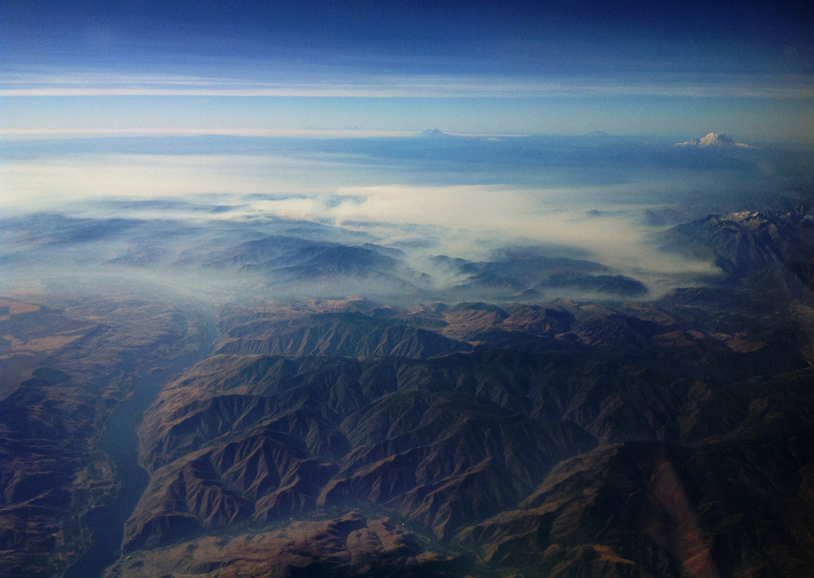
BlueSky Application and Interpretation
Smoke Dispersion Modeling
Miriam Rorig, Research Meteorologist, USDA Forest Service, AirFire Team
Susan O’Neill, Research Scientist, USDA Forest Service, AirFire Team
Photo Seattle Times, 9/2012
Photo Seattle Times, 9/2012

Slide 2
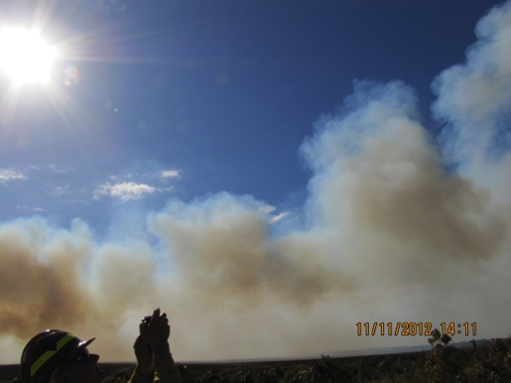
Objectives
What is smoke dispersion modeling?
What goes into smoke dispersion modeling?
How to interpret and use smoke dispersion models
Comparing monitoring observations and model output
Hands-on: Introduction to the BlueSky Playground
Hands-on: Introduction to Trajectories
Notes:
Goal – demystify models, understand how they work they are useful

Slide 3

… Fire Happens
Notes:
These are fire detections, no measure of fire size. Where there’s fire, there’s smoke.
Clearly shows the prevalence of fire in the SE (vast majority of these fires are prescribed fires)
The Southeast averages 6-8 million acres of prescribed fire per year
From 1995-2005 the average number of acres burned by wildfires in the U.S was 5.7 million. 2004-7 has seen 8-10 million acres burned in wildfires.
In Florida the average wildfire season burns 238,000 acres while prescribed fire accounts for around 2 million acres

Slide 4
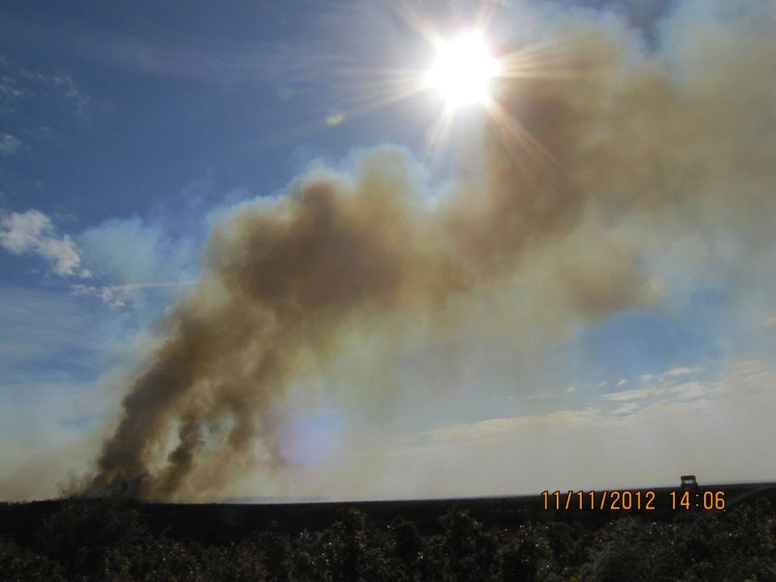
Smoke Modeling
Helps answer the questions – Where could my smoke go? How thick could it be? Who or what may be impacted?
Models give you information on a range of possible future outcomes
Models do NOT tell you with certainty what will happen in the future
… all models are wrong, most models are useful
Notes:
Why use smoke models?

Slide 5
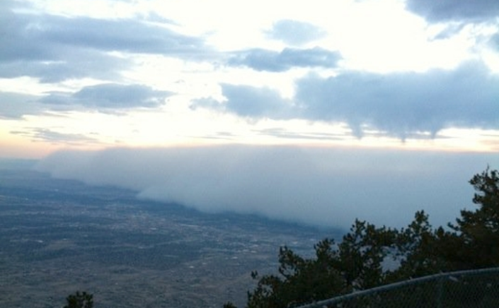
Albuquerque NM, Wallow Fire, 2011
Wildland Fire Air Quality Response Program
Provide for:
  Public Health
  Fire Fighter Safety
  Transportation Safety
By:
  Modeling
  Monitoring
  Messaging
Notes:
Smoke plume from Wallow Fire settled over ABQ. People panicked because they didn’t know what was happening, called 911, crashed the 911 system. When you keep people informed, this doesn’t happen. Communication is vital; models help you communicate potential smoke impacts. Showed the need for ARA’s.

Slide 6
BlueSky Modeling Framework v 3.5
Fire
Info
Met
WRF
MM5
NARR
Station data
Idealized
SMARTFIRE2
ICS-209
Rx Sys
Manual
Other
Fuels
FCCS
FCCS-LF
NFDRS
Hardy
GVDS
LANDFIRE*
Ag*
Other
Total Consumption
CONSUME 3
FOFEM
FEPS
EPM
FLAMBE
FINN
ClearSky (Ag)*
Satellite*
Other
Time
Rate
Rx / WF
FEPS
FOFEM
EPM
WRAP
Idealized
Manual
Other
Emissions
FEPS
Literature
EPM
FOFEM
FLAMBE
FINN
Other
Plume
Rise
Large uncertainties exist with each modeling step
Briggs
SEV
Manual
Other
Dispersion /
Trajectories
HYSPLIT
CalPuff
CMAQ
VSMOKE
Notes:
How do we determine what smoke impacts may be? We need all steps in the “ladder” above. Go over how each step is full of variability.

Slide 7
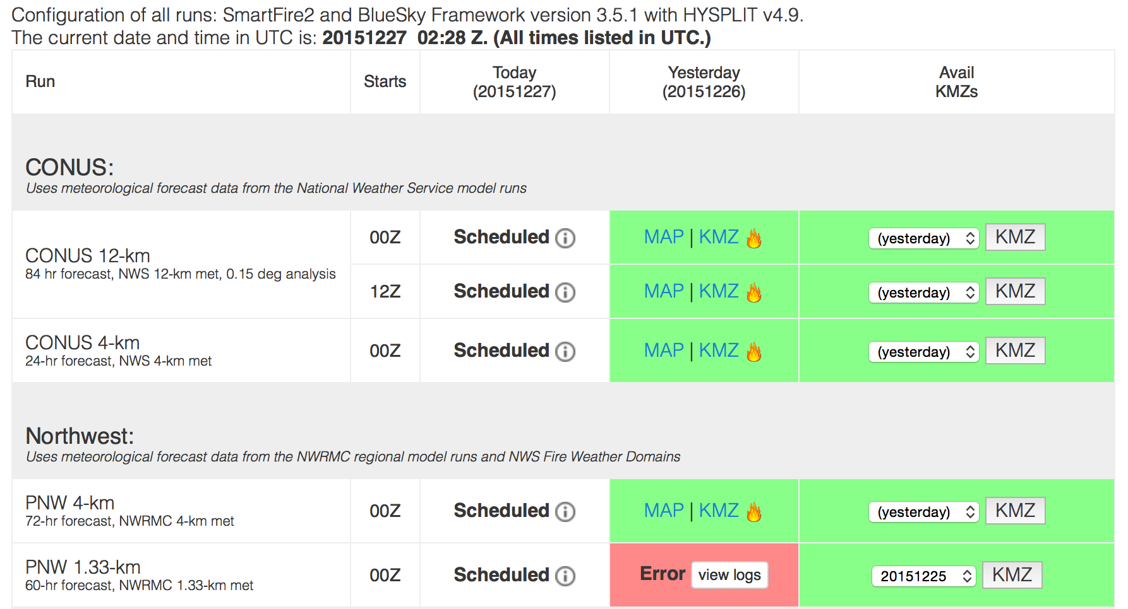

The website provides information on status of the runs
Number of fires
Successful!
Not yet started
Failures show up in red.
http://www.airfire.org/data/bluesky-daily/
Notes:
At least 12 domains per day, 6 are run twice a day (00Z, 12Z) – 18 hysplit particle runs. Mention FW1km domains.
This does not include custom runs.

Slide 8
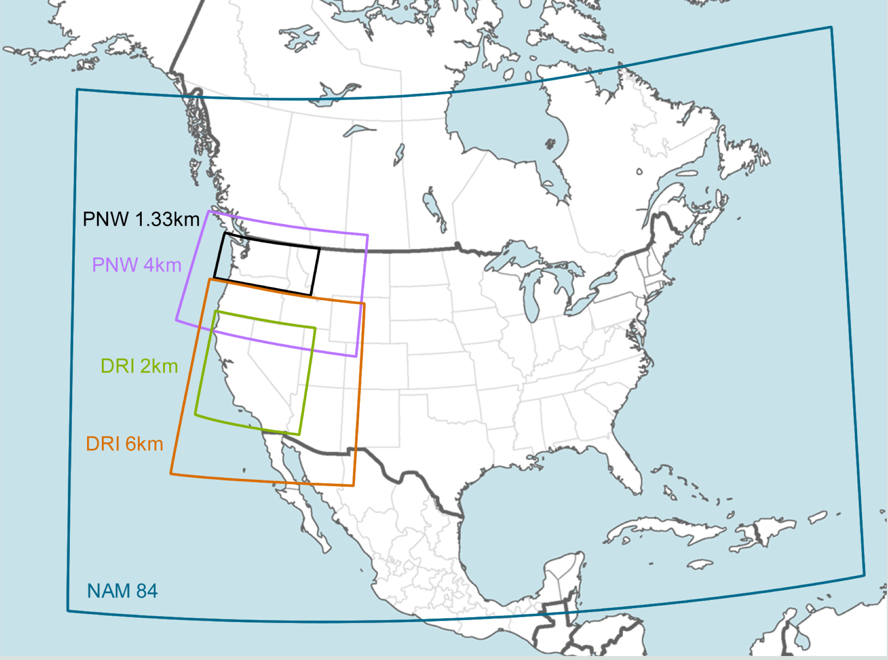
Alaska
Daily BlueSky Production Runs
http://www.airfire.org/data/bluesky-daily
Notes:
Not all domains shown here – more than one CONUS domain, FW1km domains during fire season, other regional domains that are sporadically available.

Slide 9
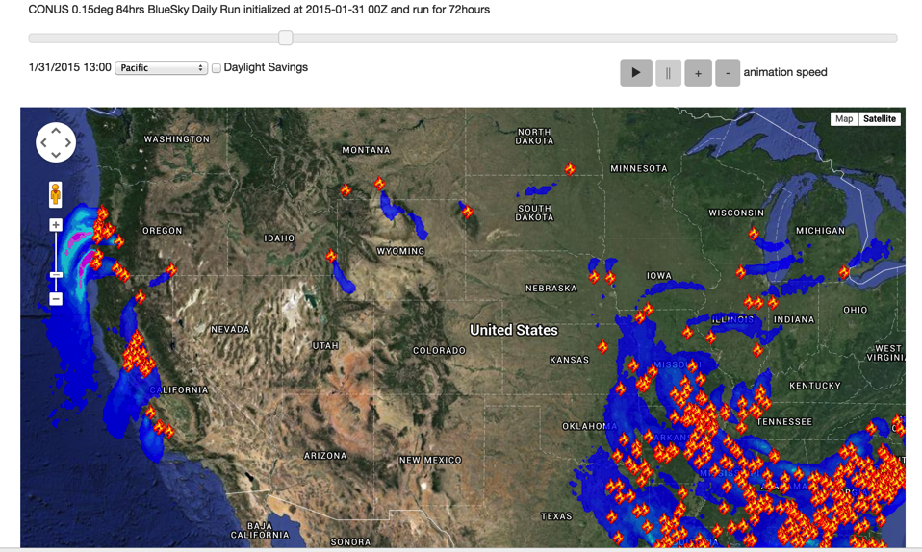
Daily BlueSky Production Runs
1/31/2015 Satellite Fire Detections & PM2.5, 12km http://www.airfire.org/data/bluesky-daily/
Notes:
Example of BlueSky output with fire locations and PM2.5 predictions.

Slide 10
What am I looking at to evaluate the models?
Visible satellite imagery (look at several!) – compare where smoke from your fire is this morning compared with yesterday’s model run
Current PM_{2.5} monitoring data – compare this morning’s values with yesterday’s model runs
Today’s model runs (seek out highest resolution available) – how do they compare with yesterday’s model runs? Is your fire missing from today’s run (cloud cover, e.g.)? Try Playground.
Notes:
How do you figure out if the model is “right” or “wrong?”

Slide 11
Satellite imagery and BlueSky output of Soberanes smoke, Wednesday September 22 (afternoon)
Notes:
Compare BlueSky with satellite images. They won’t always match because BlueSky is ground-based smoke, and satellite can be at any level in the atmosphere.

Slide 12
Satellite imagery of smoke from Soberanes fire (CA)
Sept 21, 2016, 9AM PDT
Notes:
Same fire, previous day

Slide 13
BlueSky output for Soberanes fire (CA)
Sept 21, 2016, 9AM PDT
Notes:
Surface PM2.5 does not match the satellite image (previous slide)

Slide 14
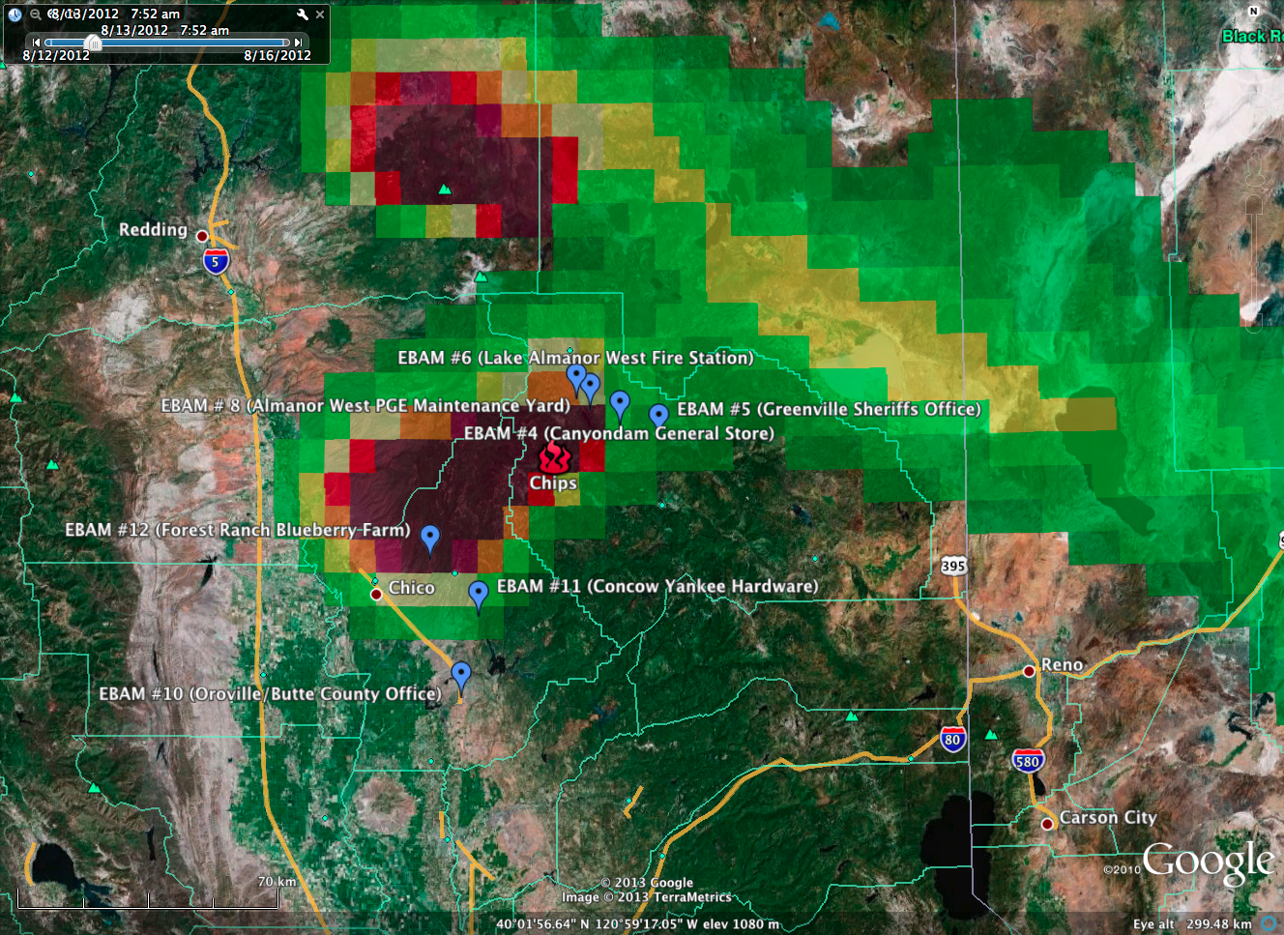
Monitor comparisons - Chips Fire, BlueSky Output for 8/13/2012
Down-drainage flow overnight and early morning – which drainage?
Notes:
Compare BlueSky with monitoring data. Looking at model every day showed smoke going down the same (wrong) drainage.

Slide 15
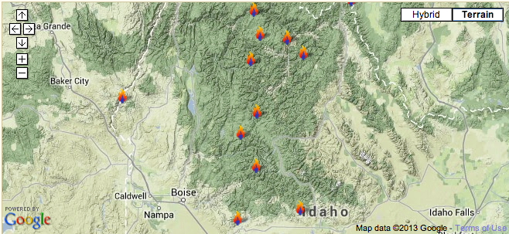
Southern Idaho fires – Summer/Fall 2012
Notes:
What to do if fire size in BlueSky is off by a large amount? – Example of ID fires 2012

Slide 16
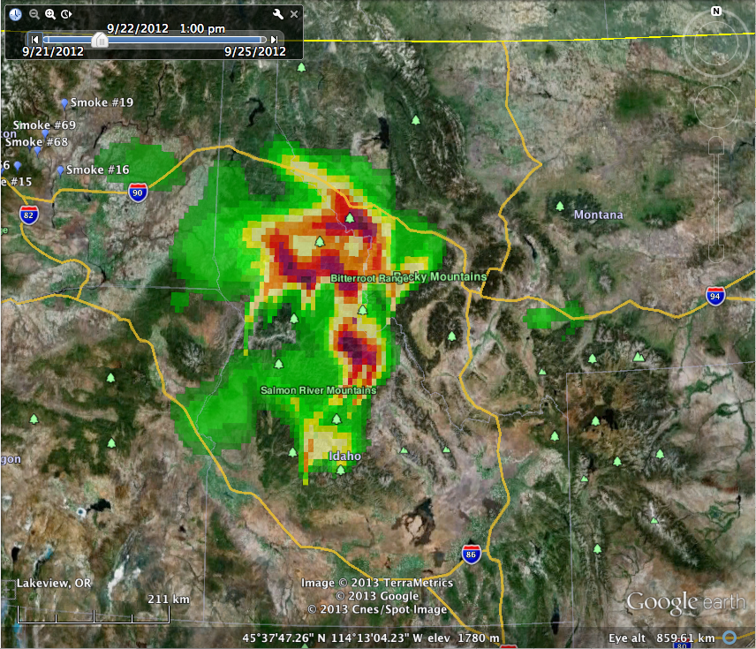
100% estimated fire growth
Notes:
PM2.5 concentrations calculated from default fire sizes used in BlueSky daily run

Slide 17
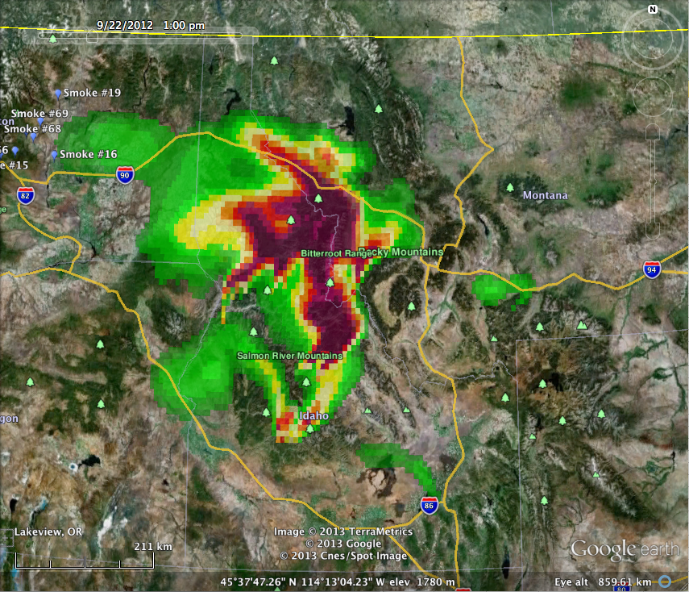
300% estimated fire growth
Notes:
PM2.5 concentrations calculated from 3 times the default fire sizes used in BlueSky daily run

Slide 18
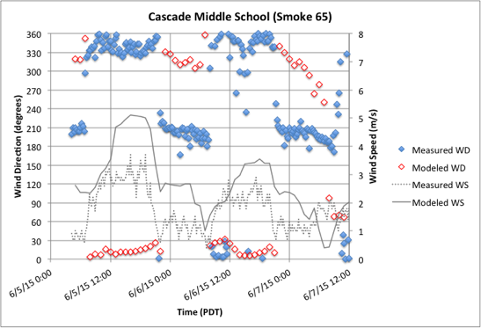
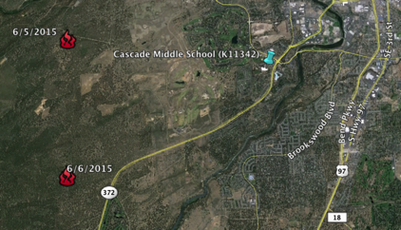
4km BlueSky run, valid 19:00 PDT 6/6/2015
Notes:
Understand Bluesky “misses” can result from errors in the met model used in the dispersion model – winds are off by 90 degrees or more at the time of the intrusion.

Slide 19
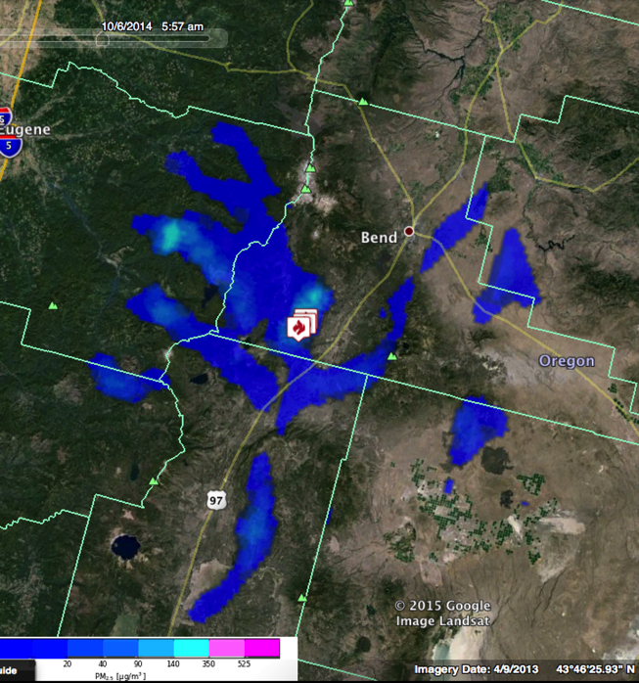
Daily scheduled BlueSky run
PNW
4km
10/6/2014 5am
Notes:
Model resolution can be very important, especially in areas with narrow drainages. 4km resolution
http://viewer.smoke.airfire.org/run/hysplit-pp/PNW-4km-Bend-Intr/2014100500/

Slide 20
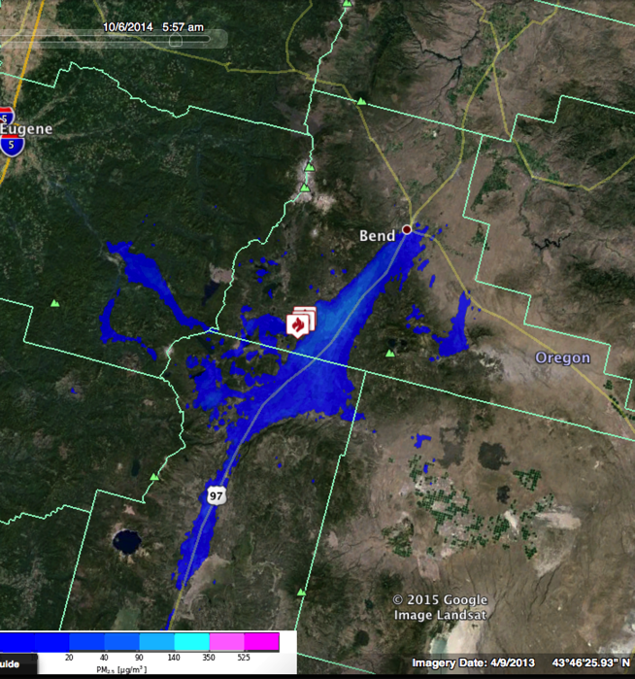
Custom hi-res BlueSky run
NWS 1km
10/6/2014 5am
Notes:
Vs. 1km resolution

Slide 21
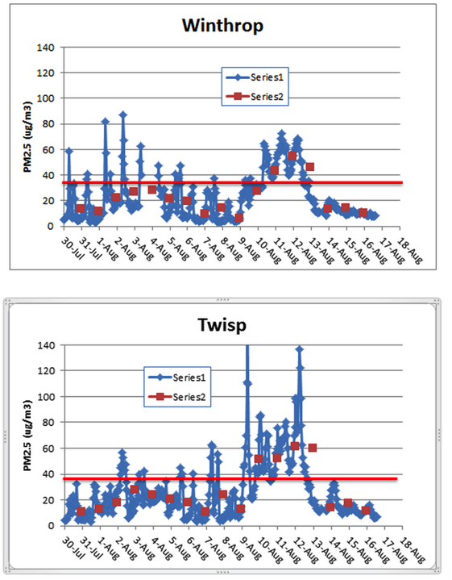
Carlton Complex August 2014
Washington Smoke Blog
On this gorgeous, clear day with no smoke, let's take a look at the differences between two air quality monitors located less than 9 miles apart in the same Methow Valley. The blue graphs indicate 1-hr average concentrations of PM2.5 while the red data points are 24-hr averages. Note that while the 24-hr values trended rather similar for the two sites (expected as they are spatially close) the peak 1-hr values differed greatly!
Posted by Mike Broughton, FWS, ARA
Notes:
Read the smoke blog to the class, then say, lets take it a step further and look at the models.
http://www.wasmoke.blogspot.com/search?updated-max=2014-08-18T11:08:00-07:00&max-results=8&start=4&by-date=false
Talk about 1-hr and 24-hr concentrations. NAAQS are a 24-hr std. Does smoke stay the same over a 24-hr period? Why or why not?
Use this example to talk about: grid resolution, comparing with monitoring data, timing of impacts and met models being off, calibrating your brain/experience
http://kcts9.org/programs/in-close/environment/wildfires-and-climate-change
http://kcts9.org/programs/in-close/environment/carlton-complex-progression-map

Slide 22
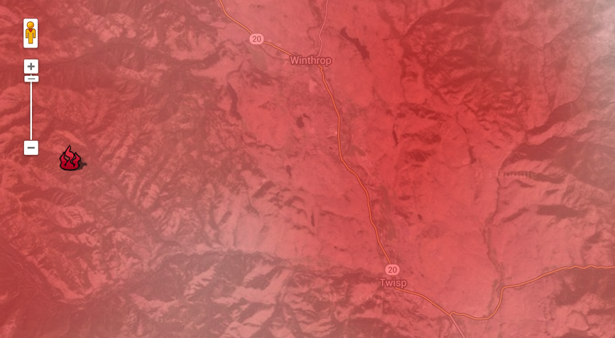
Carlton Complex 2014080400Z, 8/4/2014 6am, 12 km Domain
Winthrop
Twisp
Notes:
Weather model winds – what if they are off by 30 degrees? Does it matter so much with this resolution?

Slide 23
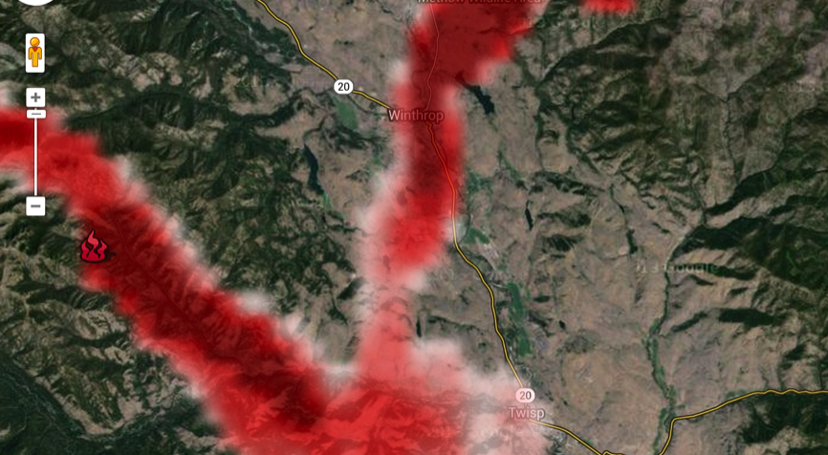
Carlton Complex 2014080400Z, 8/4/2014 6am, 1.33 km Domain
Winthrop
Twisp
Notes:
Weather model winds – what if they are off by 30 degrees at this fine resolution?
The obs showed Twisp getting hit harder, yet BlueSky typically hit Winthrop harder – again shows importance of looking at models every day to see patterns

Slide 24
Are models worthless?
AQ monitor shows moderate-high PM_{2.5} concentrations; models shows none. Are the models wrong?
Models shows PM_{2.5} concentrations in a different location (drainage) than the AQ monitor. Are the models wrong?
Based on observations, the models are not accurately predicting the timing of smoke impacts. Are the models wrong?
Model input is incomplete and inaccurate (by design!) – it’s an approximation
Model configuration can have a big effect on model output
Don’t think the observations are the “truth” either:
  Federal Reference Monitor? (probably not)
  Hardware issues (pump failures, clogged filters, etc.)
  Apples-to-oranges comparison: grid cell averages vs. point observations (could be differences in temporal averages too)
Bottom line: Models and monitors give you complementary information – not direct comparisons!

Slide 25
Interpreting Model Runs
  Get as much information as possible on what went into the model runs – includes fuels, weather, fire location, fire size, etc.
  Familiarize yourself with model limitations
  As much as possible, do some game-playing (change fire size, fuels, timing, etc) – request custom runs, if possible
  Compare different model outputs (different domains, NOAA smoke forecasts, dispersion vs. trajectory, etc.)
  Mentally adjust output to compensate for known inaccuracies (too many acres, dispersion down wrong drainage, etc.)
Use all available information to help you anticipate smoke impacts:
Monitoring data
Model output
Human observations
Remotely sensed data (e.g. satellite data, heat signatures)
Local knowledge
More!
Notes:
To sum up what we

Slide 26
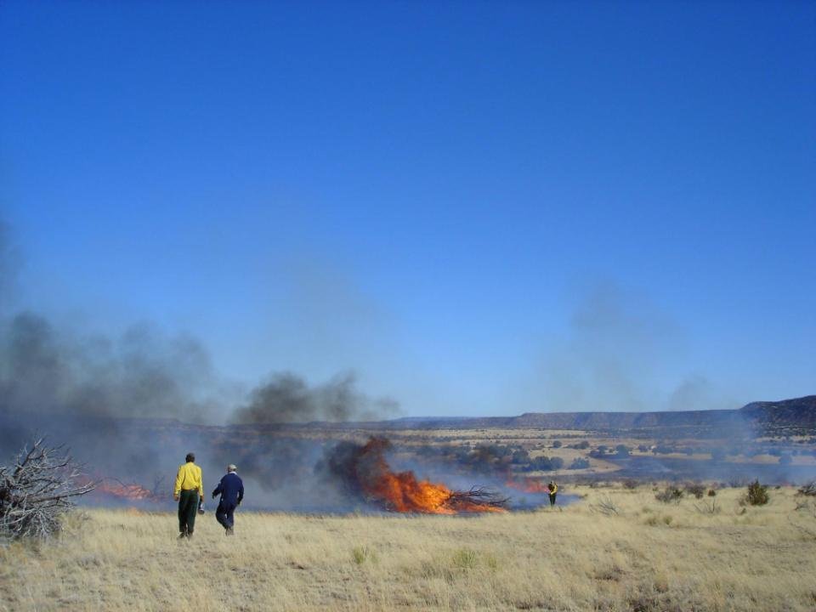
Models Available Online
BlueSky Wildfire Operational Runs
http://www.airfire.org/data/bluesky-daily/
BlueSky Playground – Do your own smoke (PM2.5) modeling
http://playground.airfire.org/
NOAA HYSPLIT (Dispersion and Trajectories)
http://ready.arl.noaa.gov/HYSPLIT.php

Slide 27
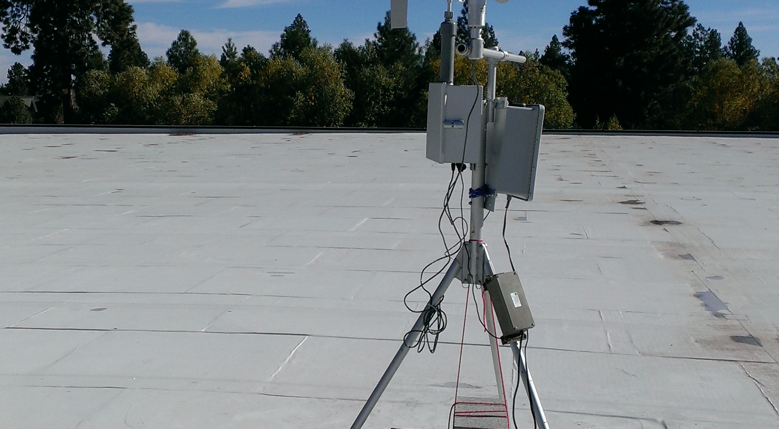
Additional Online Tools
Monitoring report page – NEW http://smoke.airfire.org/monitoringReport/
Smoke values at risk page – in testing http://smoke.airfire.org/complexityTest/
“Easy” trajectory page http://smoke.airfire.org/trajectories/
Ventilation Climate Information System http://smoke.airfire.org/vcis/

Slide 28
From the NWS Juneau, AK, Forecast Discussion, May 13, 2014:
(Subsequently picked up by the Washington Post, Slate.com, and others)
“Picking a model of choice for the day is a little like speed-dating: too little time/information to make up the mind leading to regrets by the end of the date/shift.”
-Wes Adkins, Meteorologist, National Weather Service, Juneau, AK
You can speed-date for BlueSky daily production runs at
http://www.airfire.org/data/bluesky-daily/

Slide 29
Key Point: Both smoke dispersion modeling systems and monitoring data are representations/approximations of reality – not exact “pictures” of PM2.5 concentrations. They both provide very useful information, and are even more useful when used together.

Slide 30
If you understand the uncertainty and variability in the models, they are powerful and useful tools that help you anticipate (predict) and communicate smoke.

Slide 31
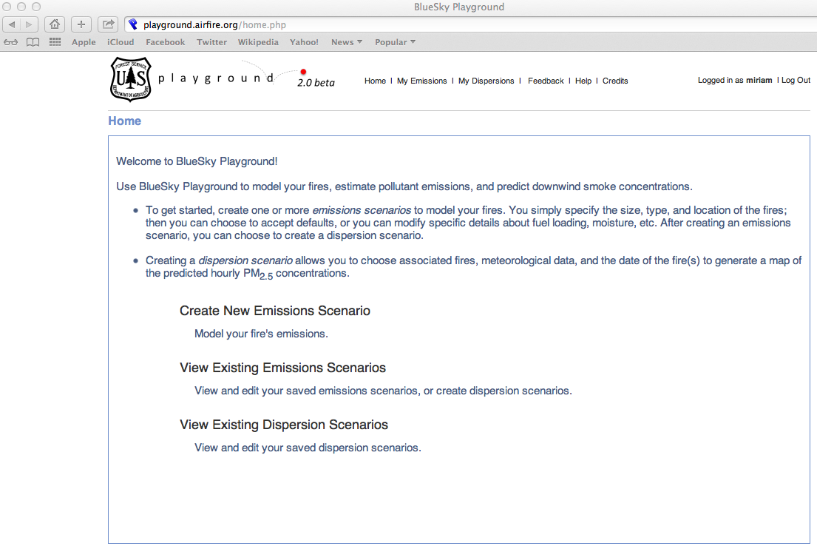
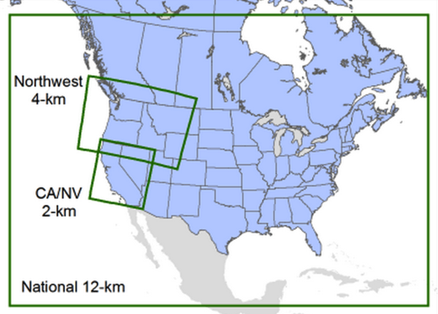
BlueSky Playground – allows users to do custom runs
playground.airfire.org

Slide 32
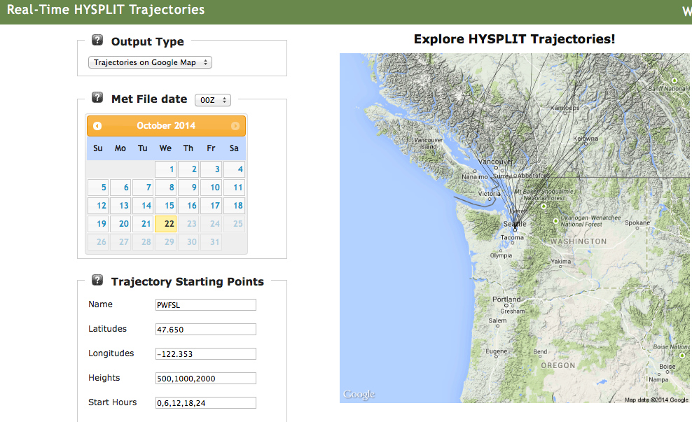
Trajectories – allow users to get “3-D” picture
smoke.airfire.org/trajectories

Slide 33
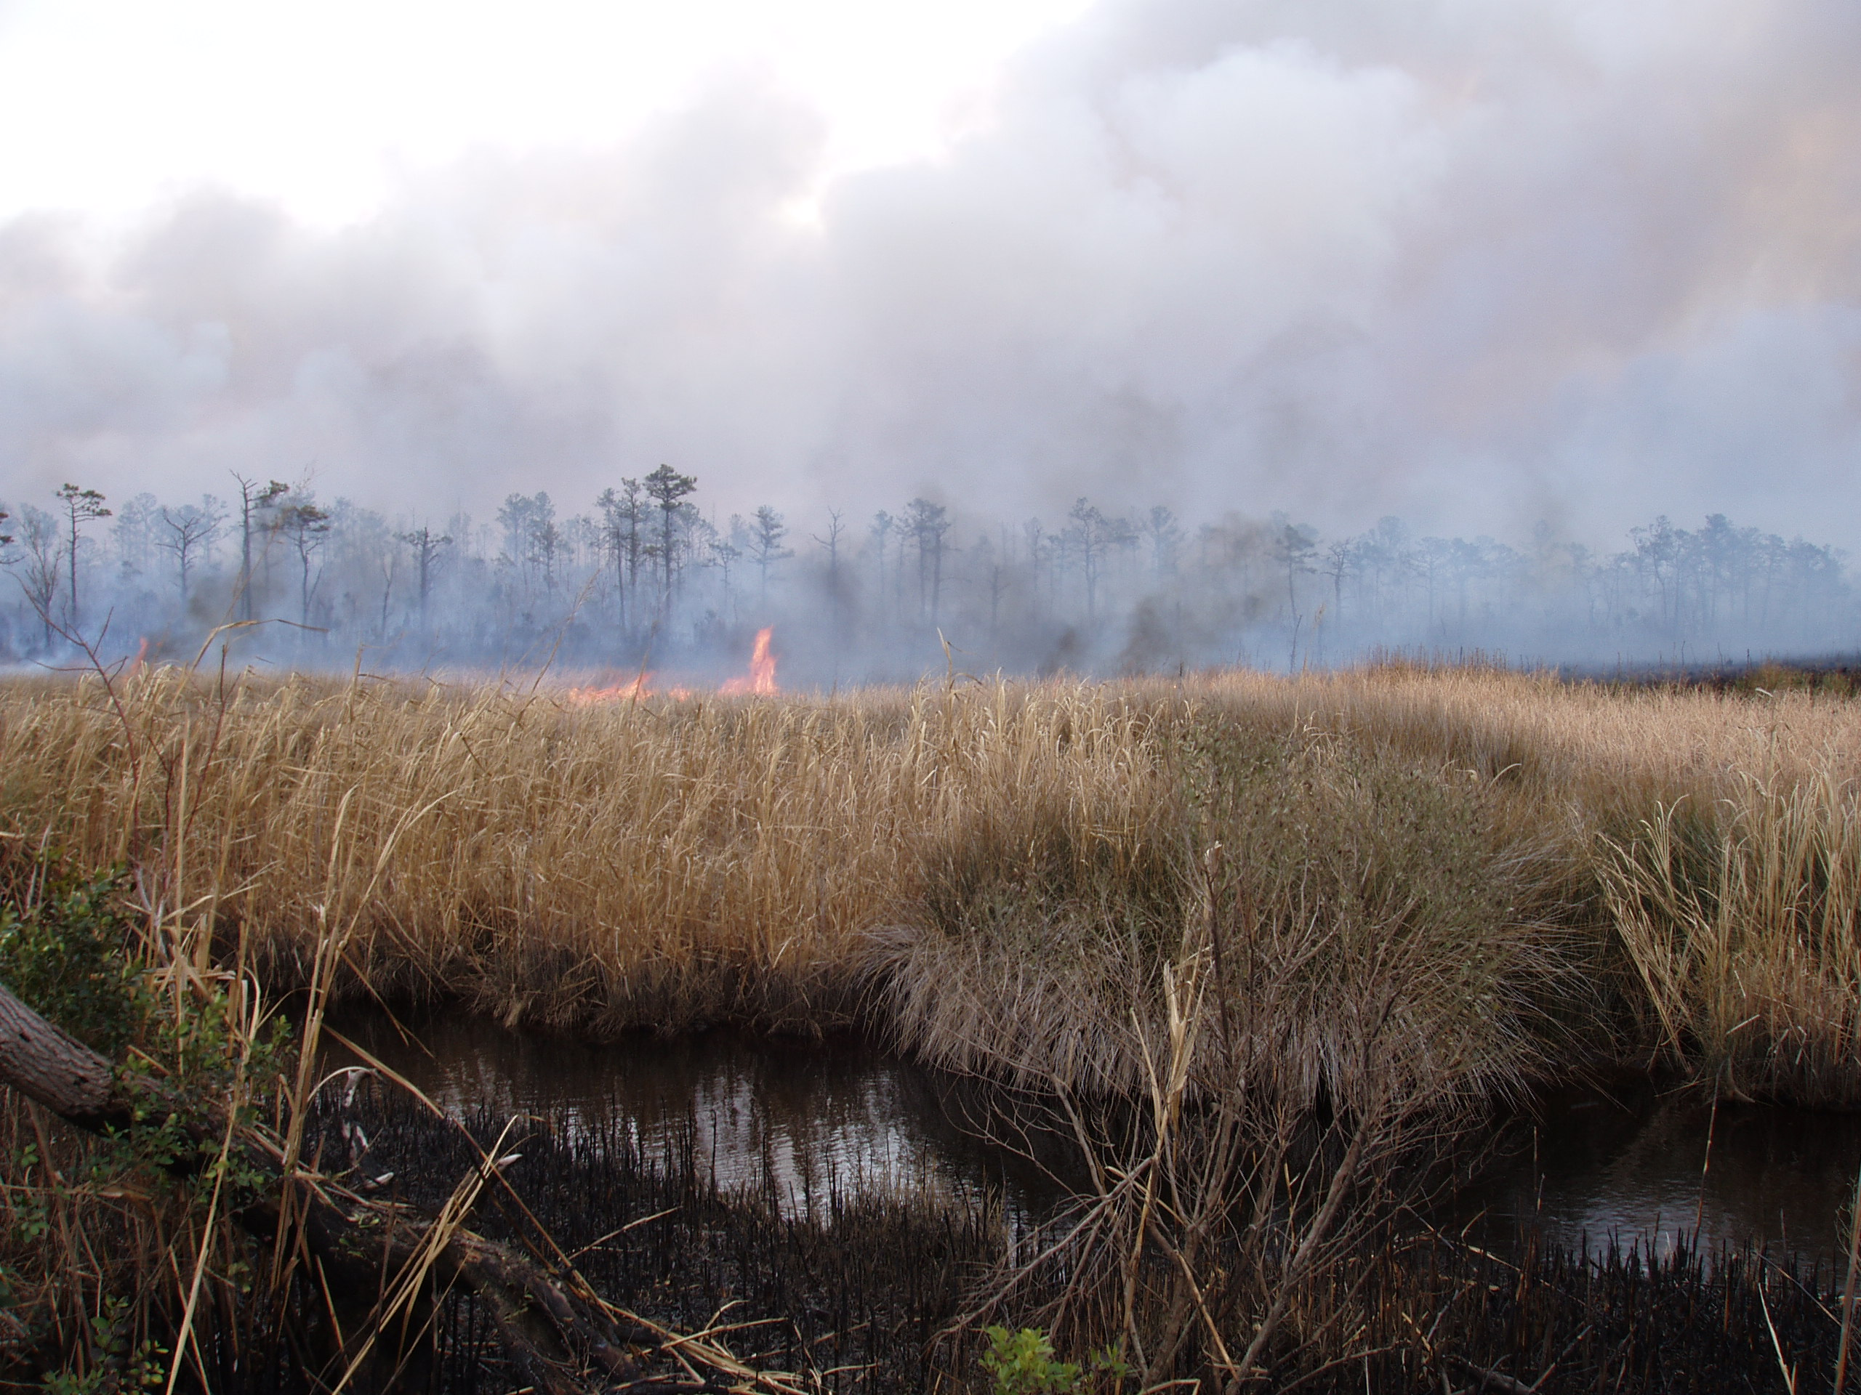
Collaborative Partnerships
NWCG Smoke Committee
NOAA
EPA
NPS
NIFC
University of Washington
Desert Research Institute
Washington State University
University of California
University of British Columbia
Sonoma Tech Inc.
Mazama Science
Natural Resources Canada
Canadian Forest Service
Many others
Ex: Weather Data:
National Weather Service (1-km FW domain)
Desert Research Institute
State of Florida
University of Washington
University of British Columbia

Slide 34
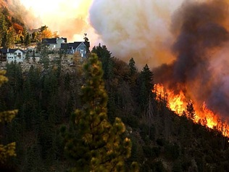
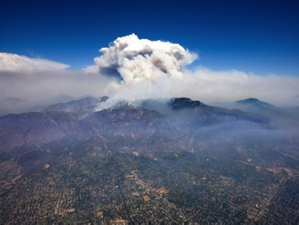
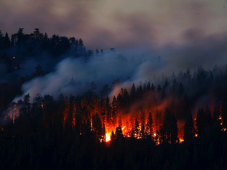










Thank you
More information:
Miriam Rorig
mrorig@fs.fed.us
mrorig@gmail.com
206-732-7843
Susan O’Neill
smoneill@fs.fed.us
susan.m.oneill@gmail.com
206-732-7851

